Slide 1

TBPB Shop Online shop marketing
Toma Alexandru
Balosu Mihai
Popescu Radu Andrei
Bacioiu Alexandru

Slide 2
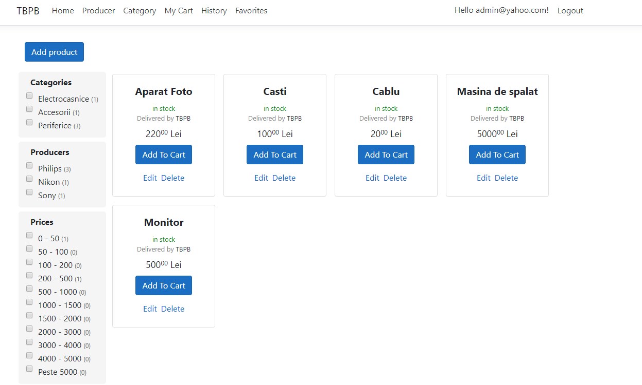
Products page This page contains all the products that our shop contains. From here, all the other actions can be performed, such as adding the product in cart or sorting the products. The admin is the only one who can edit the products or add new ones.

Slide 3
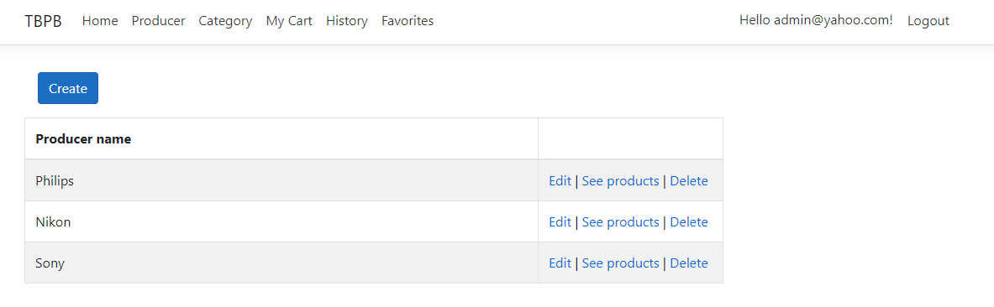
Producers page This page contains all the producers that our shop contains. The admin is the only one who can edit the producers or add new ones.

Slide 4
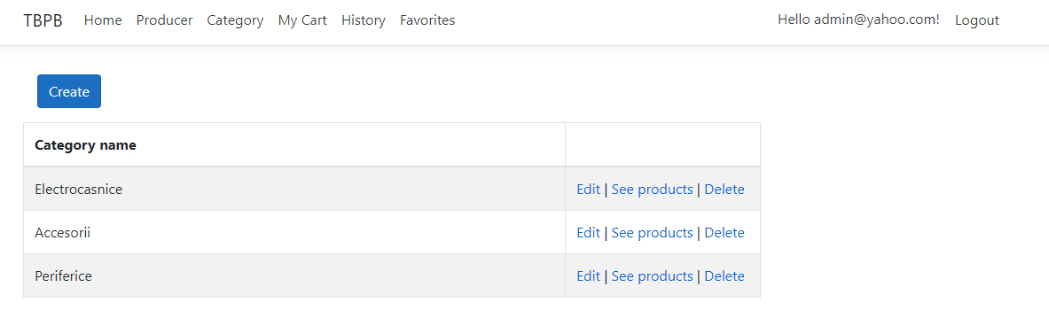
Category page This page contains all the categories that our shop contains. The admin is the only one who can edit the categories or add new ones.

Slide 5
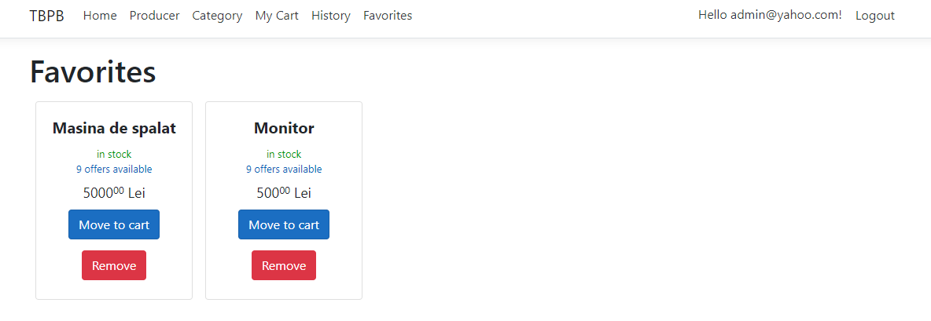
Favorites page in this page, the customer can save the products that he is not sure about whether to buy It or not.

Slide 6
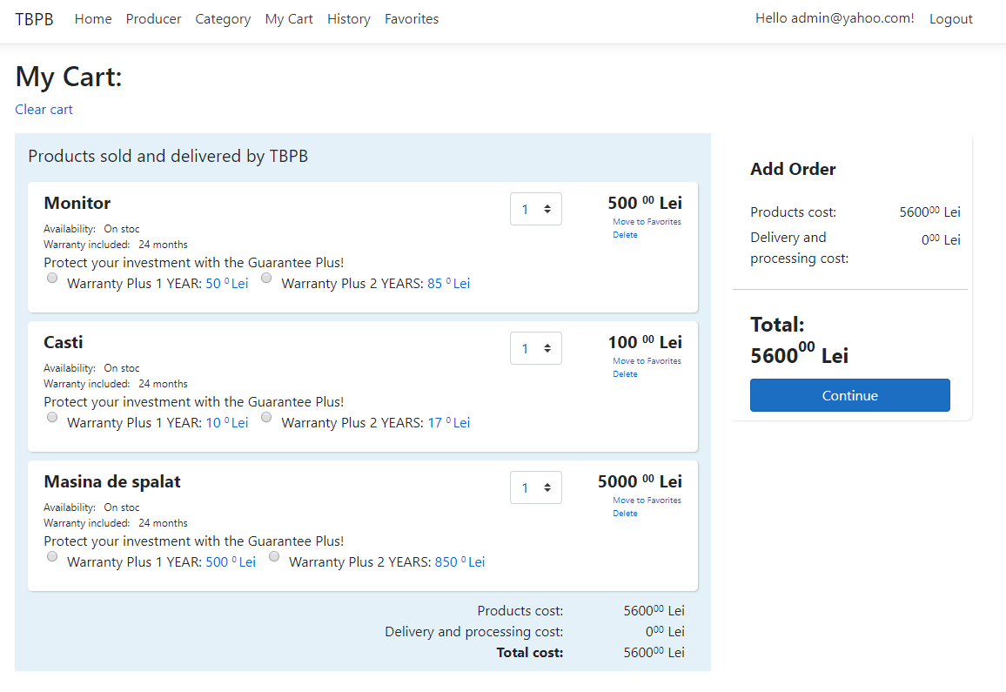
Cart page In this page, the user cart is displayed. Here, will be stored all the items that he want to buy. By clicking continue, it will be sent to the checkout page.

Slide 7
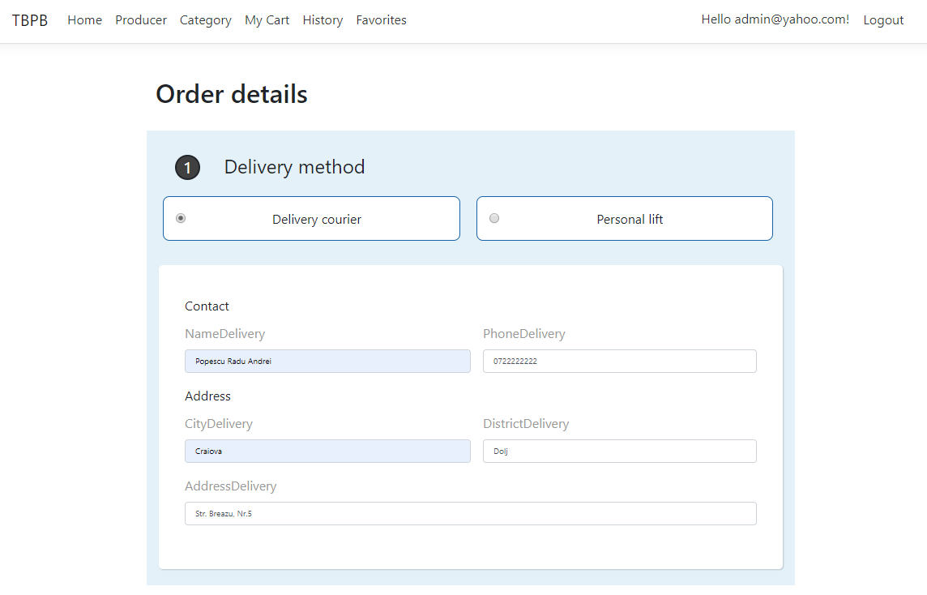
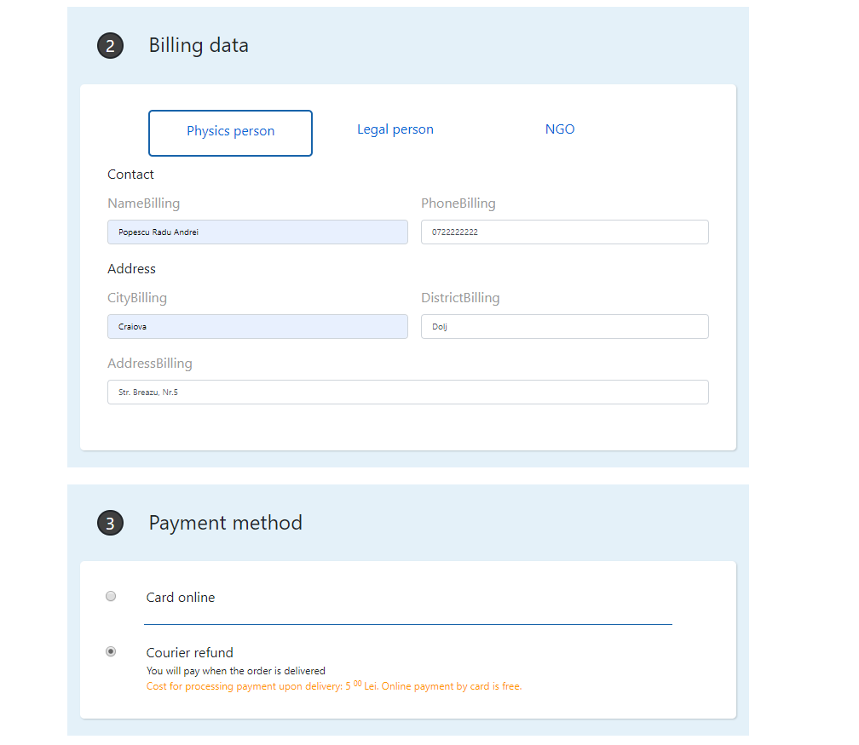
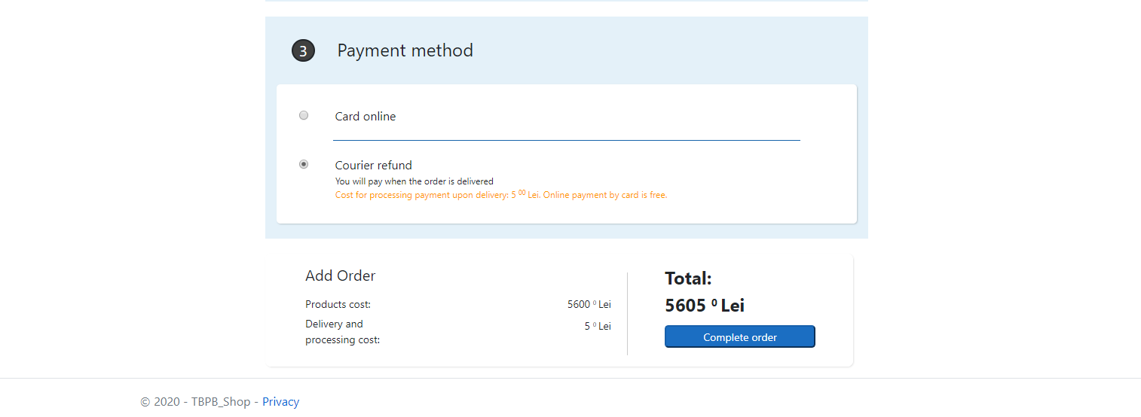
Checkout page In this page, the user will enter his personal dates, and will select the payment method. By clicking complete order, the order will appear in the history page.

Slide 8
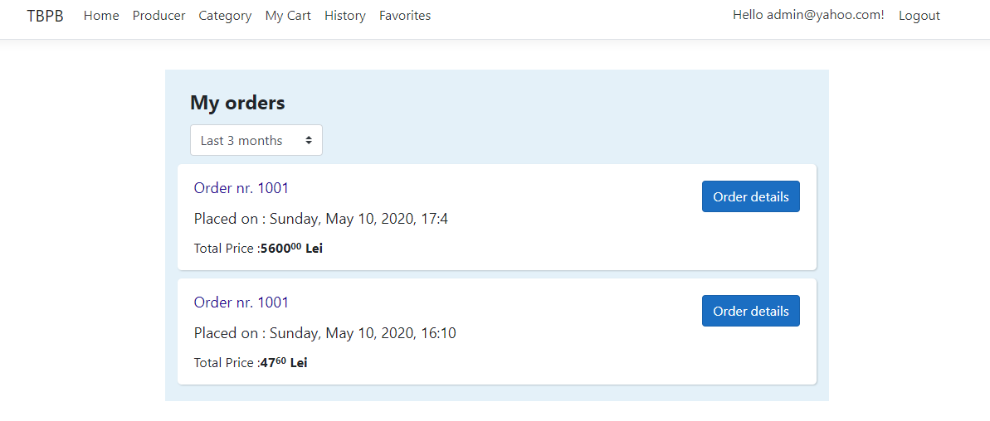
History page In this page, all the orders that a user has made will be stored here. He can check his order by clicking the order details click.

Slide 9
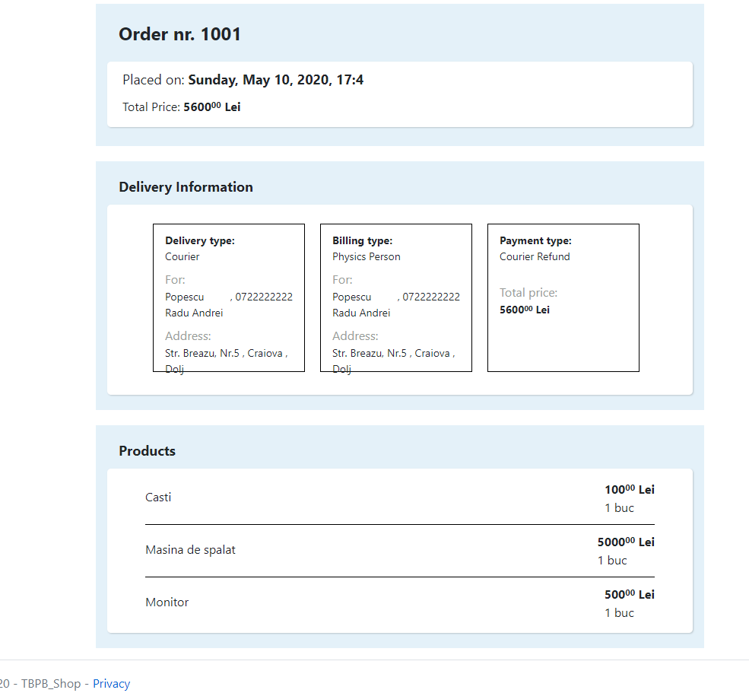
order detail page in this page, a user can see the details about an order that he had placed.

